Slide 1
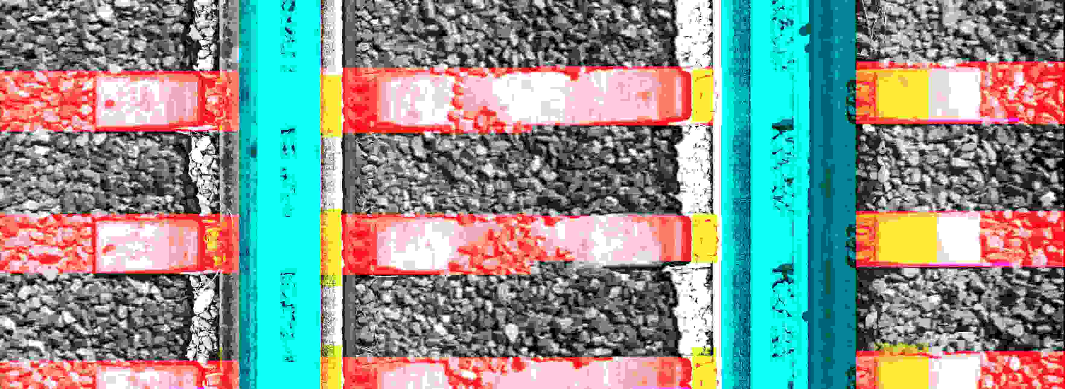
Ballast Particle Size Analysis
Automated detection of track features – rails, ties, plates
Automated image pre-processing - contrast, brightness zonal histogram equalization
Image analysis – particle detection & characterisation
1

Slide 2
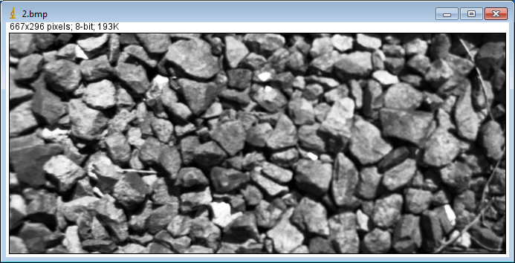
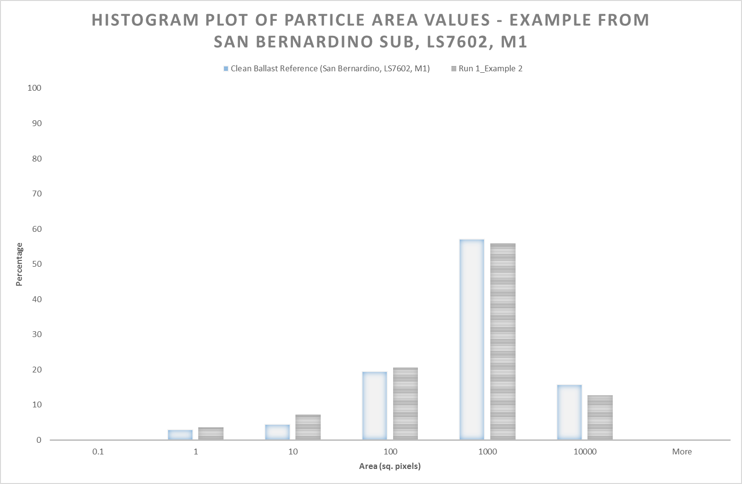
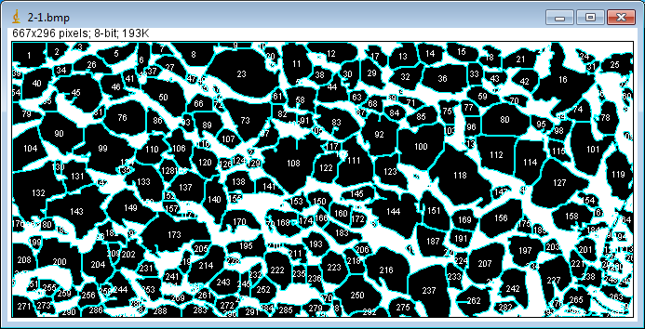
Ballast Particle Size Analysis – preliminary results
Clean Ballast
2

Slide 3
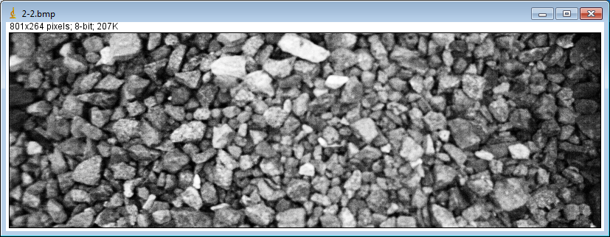
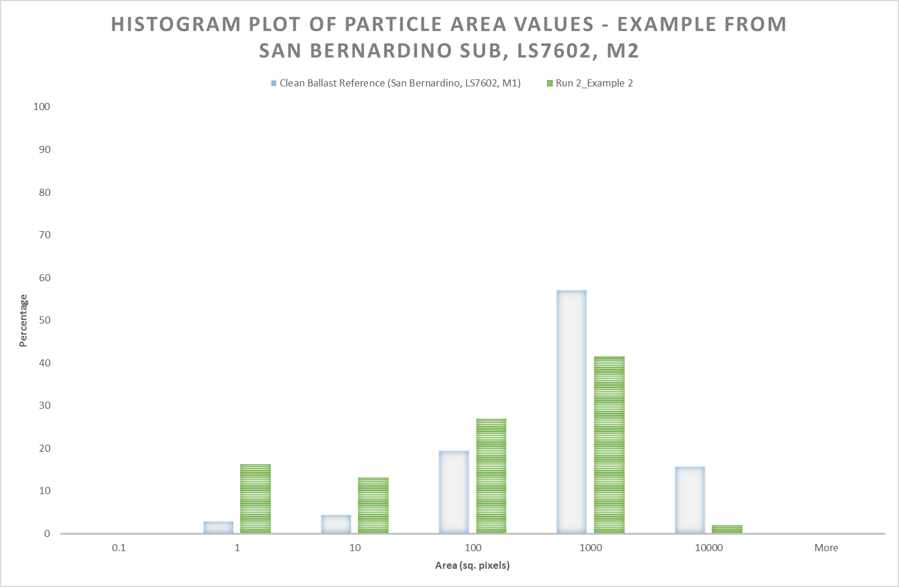
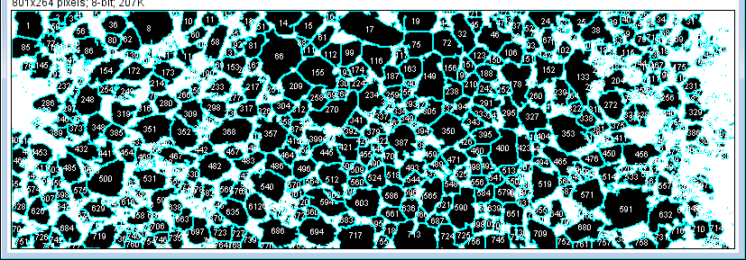
Ballast Particle Size Analysis – preliminary results
Undersize Ballast
3

Slide 4
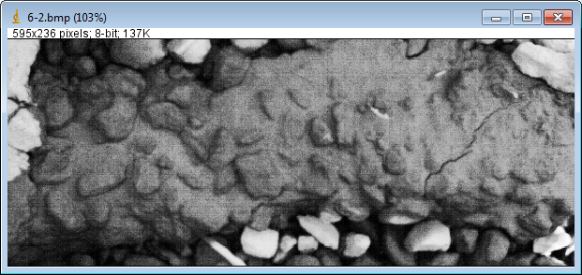
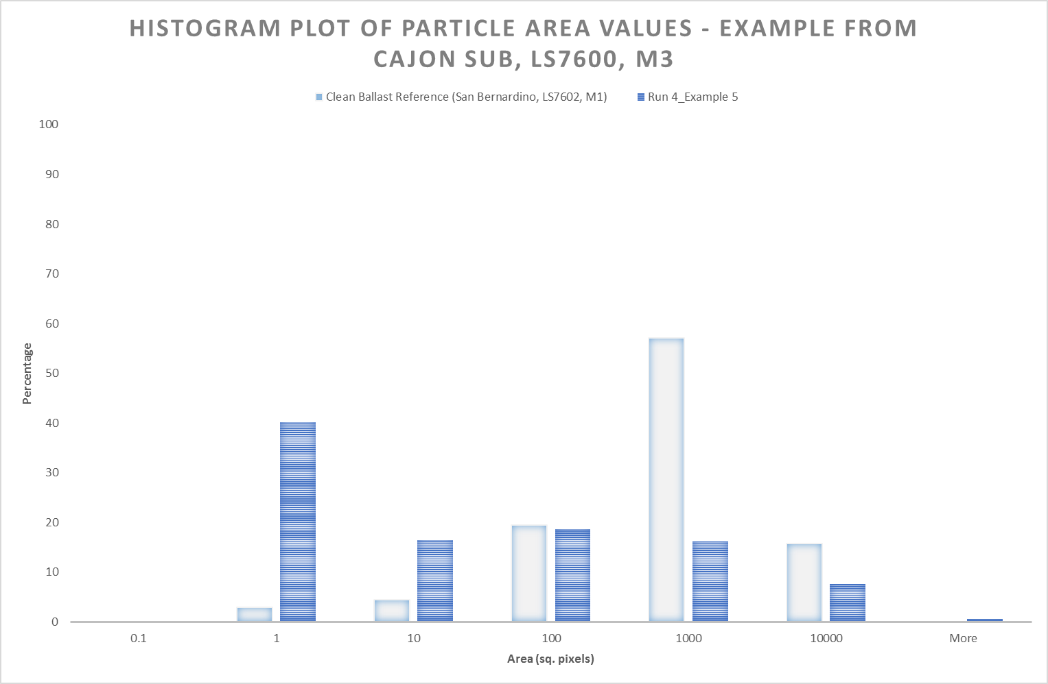
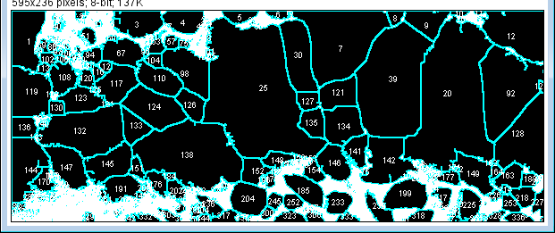
Ballast Particle Size Analysis – preliminary results
Muddy Ballast
4

Slide 5
Ballast Particle Size Analysis – preliminary results
5

Slide 6
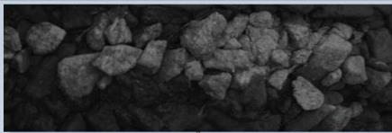
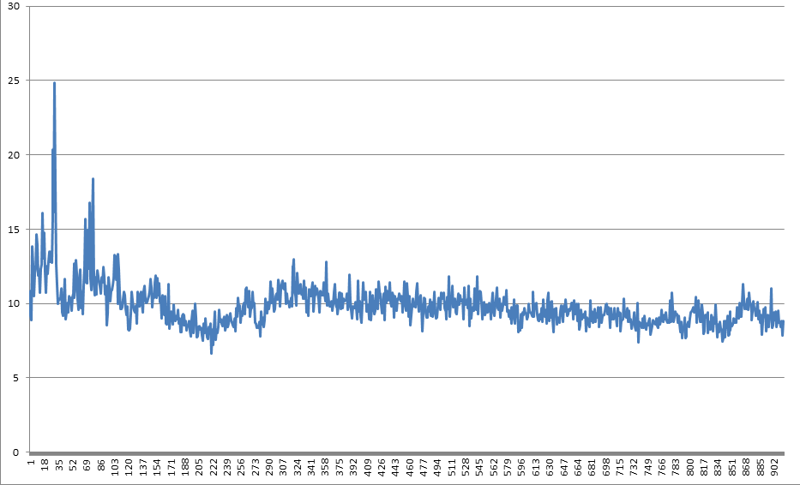
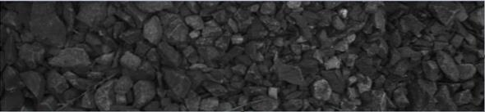
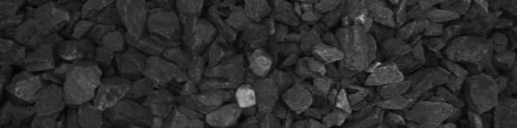
Automated Ballast Particle Size Analysis
Relative Ballast Particle Size

Slide 7
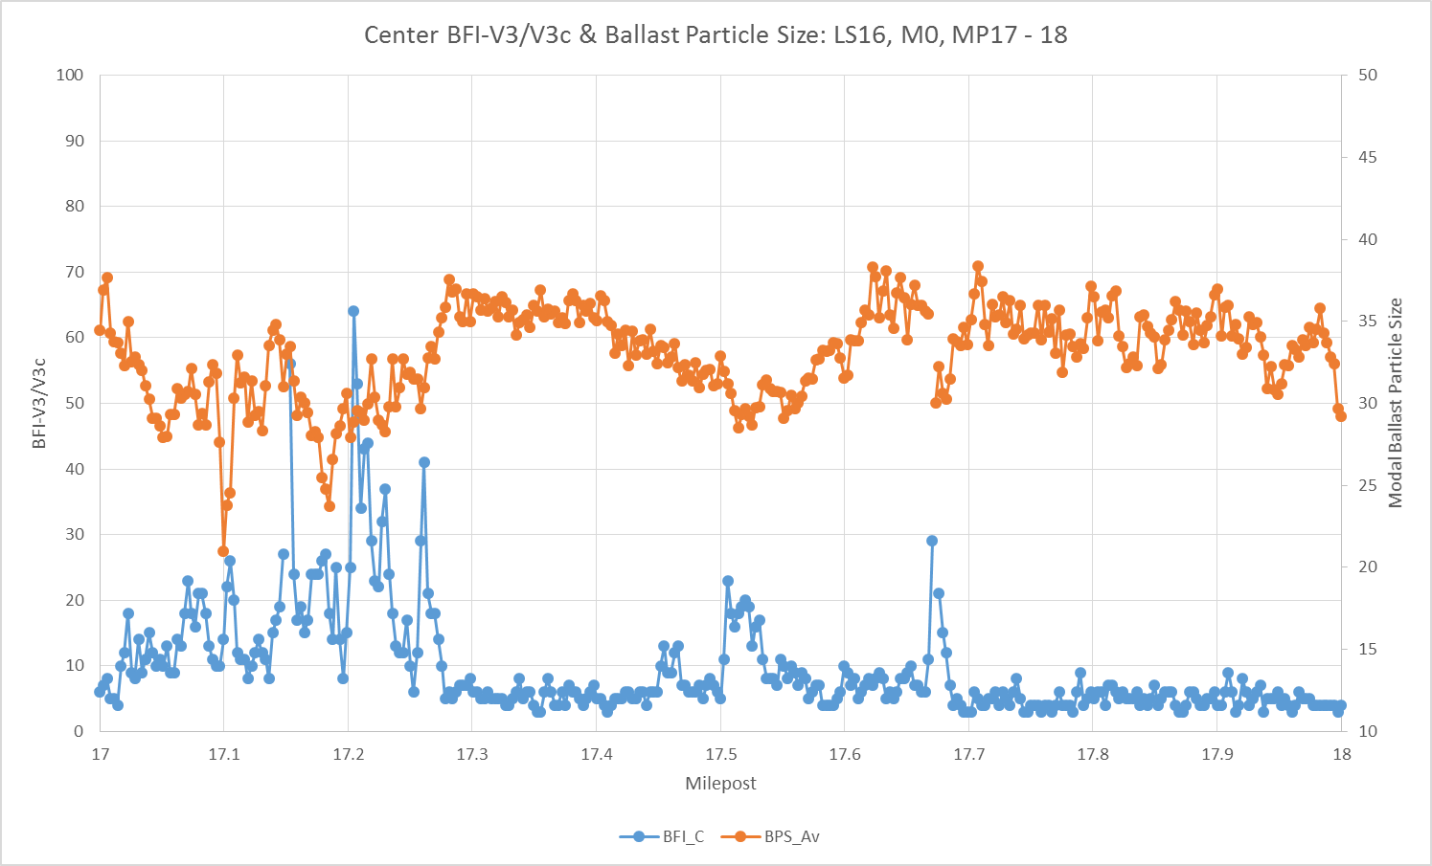
Automated Ballast Particle Size Analysis
Test Results – Main 0, MP17 to 18

